Slide 1
LoyalShare
——Win-win relationship between consumers and businesses
Zhao Haibo 21091193
Tong Haowei 21114610

Slide 2

Section 1
Market Model and Core Roles

Slide 3
Market Background
Global Growth:
The consumer electronics market is experiencing rapid growth (smartwatches, headphones, etc.).
Hong Kong & Shenzhen Advantage:
1. Hong Kong: A global financial hub, attracting international investment, In the case of dividends paid by a Hong Kong subsidiary to a mainland parent company, there is no dividend tax in Hong Kong.
2. Shenzhen: A tech and innovation hub with numerous unlisted companies, perfect for new product launches and tech-driven markets.
Challenges for Unlisted Companies
Limited Access to Public Markets
Token as a Solution

Slide 4
Market Model
Market positioning:
Product type: Electronics products and accessories.
Target price range: Mid-market ($150-$300).
Current users: Consumers who value value for money, functionality and design.
Data:
Annual income: $10M
Gross margin: 40%, gross margin of $4M
Net interest rate: 15%, net profit of $1.5M
Goals:
Sales growth: Increase sales through Token mechanism.
User engagement: Build long-term incentives to encourage more referrals and re-purchases.

Slide 5
Market Model
Core concept:
Use the Token mechanism to connect suppliers, merchants, consumers and referees, forming a mutually beneficial closed-loop ecology.
Token function:
Reward spending and recommendation behavior.
Provide dividend mechanism to encourage long-term holding.
Support commodity deduction, improve the stability of Token value.

Slide 6
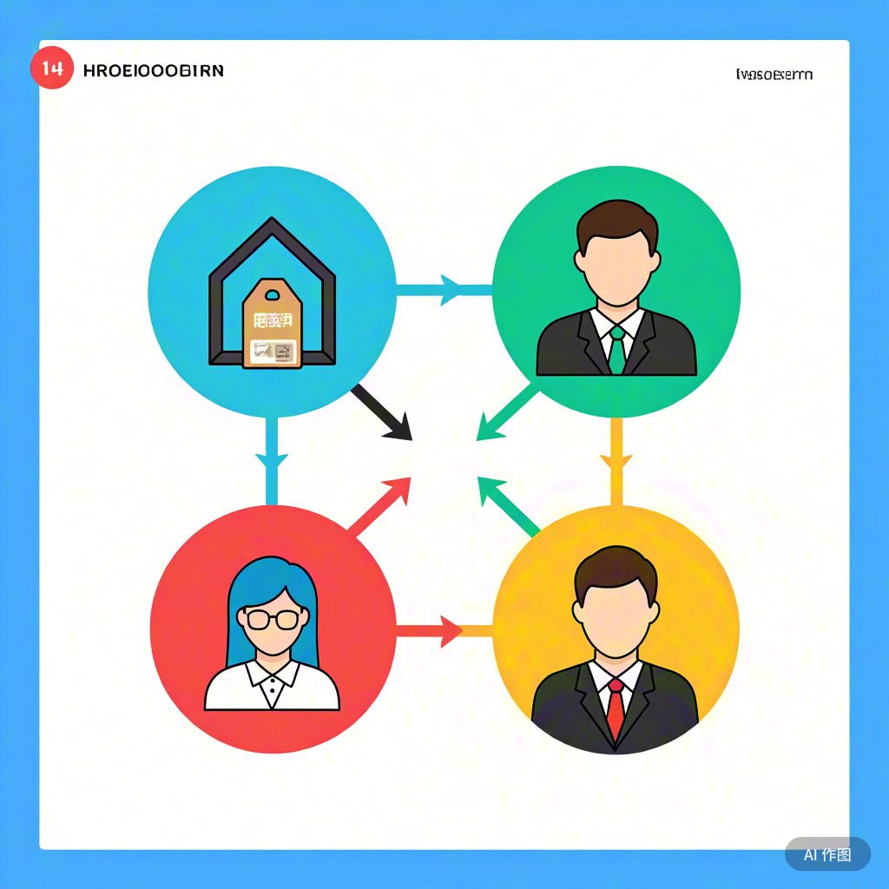

Core Roles
Supplier
Marketplace
Marketplace
Consumer
Suppliers, merchants, consumers and referrers form a mutually beneficial ecosystem through the Token mechanism.
Supplier = "commodity supplier", Marketplace = "Token issuer", Consumer = "value acquirer", Referrer = "traffic introducer"

Slide 7
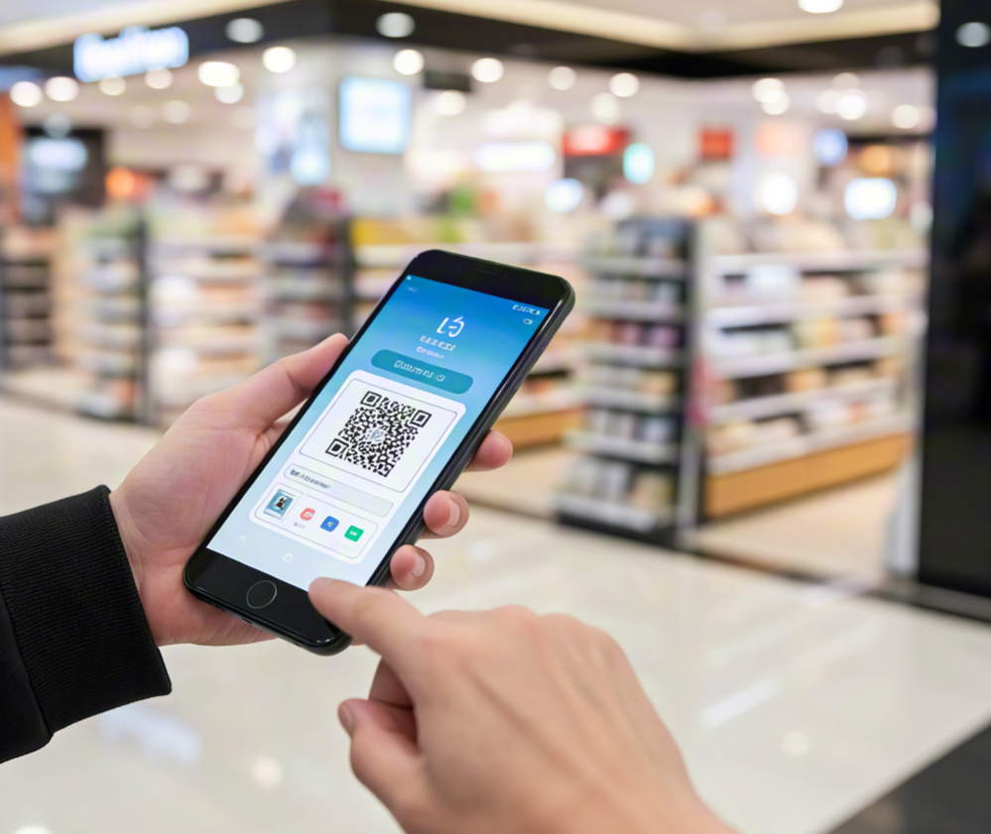
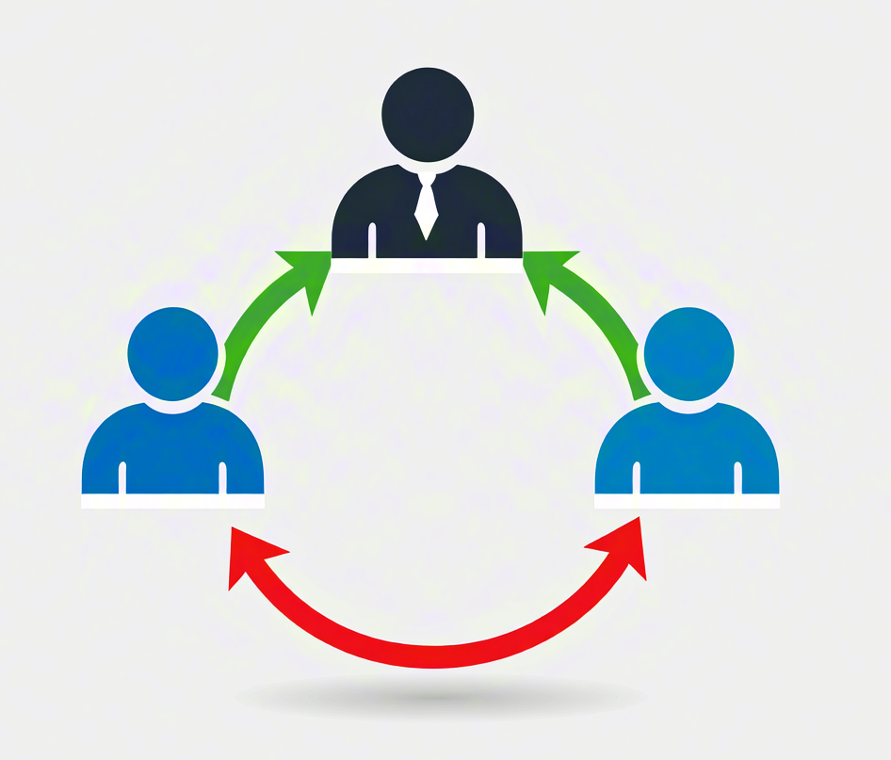
Marketplace
Marketplace: from unlisted company to tokenized enterprise
1. Unlisted companies solve the problem of not being able to distribute equity directly through tokens.
2. Token incentives bring short-term sales growth and long-term market trust.
3. Profits are linked to Token value to form a dynamic management system.

Slide 8

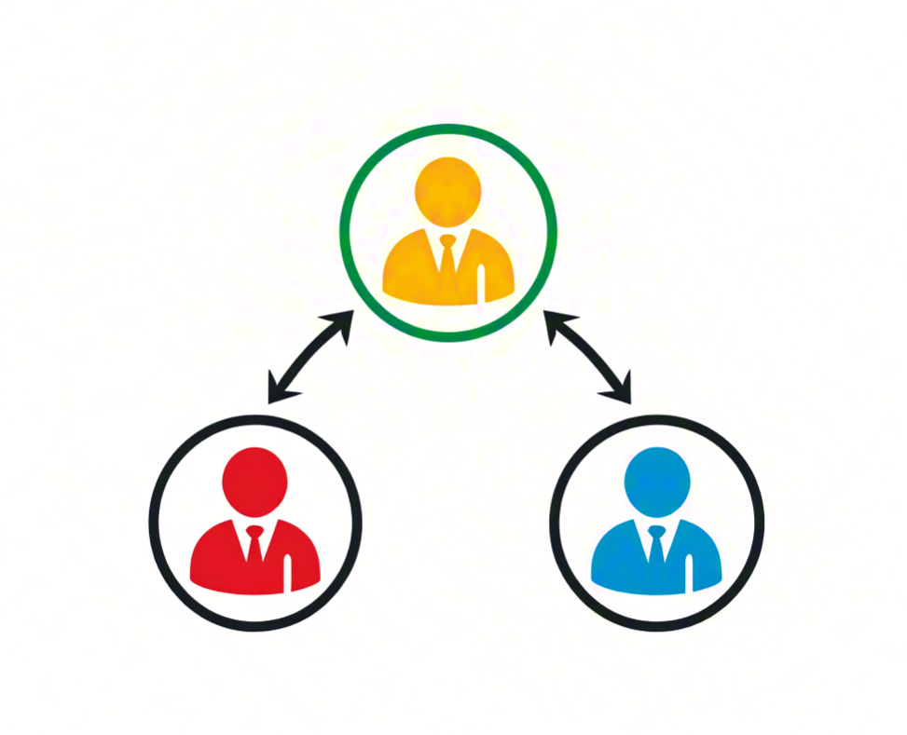
Consumer & Referrer
Consumers: Rights and flexibility
1. Consumers acquire tokens through shopping and become stakeholders in the long-term development of merchants.
2. The Token represents value and can be used both for earning rewards and for deducting the cost of goods, enhancing versatility.
3. Tokenization enhances consumer trust and stickiness with merchants.
Referrer: Promotion is revenue
1. Referrers get recommendation bonus by binding consumption to recommended address.
2. Referral rewards are tied to Token value, incentivising long-term promotion.
3. The stronger the recommendation chain, the more stable the Token ecosystem, and the revenue of merchants will also increase.
Consumer & Referrer

Slide 9

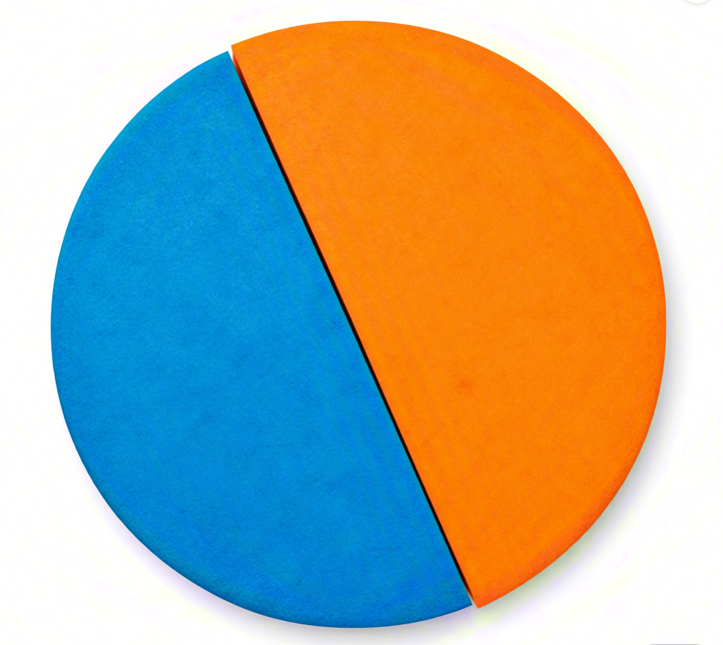
Section 2
Token

Slide 10
Three Major Token Use Cases
Consumer Rewards
1. Consumers receive 1% of their purchase amount in tokens.
2. Referrers also receive 0.1% of the purchase amount.
Deductible function
1. Tokens can be used to deduct a portion of future purchases.
Supplier Endorsement
1. Token holdings reflect consumer trust in the business's future development.
2. Businesses can showcase token holdings as trust data when negotiating with suppliers for better pricing.
3. People who hold tokens can receive a certain amount of distribution.

Slide 11
Core Logic of the Token Incentive Mechanism
Initial Issuance Mechanism
1. Based on 8% of the previous year's profits, tokens are issued to ensure a fixed total supply, ensuring scarcity and increasing market value.
2. Initial token value set at $1/token as a stable reference for holders.
3. Dynamic issuance rule:
The number of tokens issued next month is determined by the net profit from the previous month.
Next month's token price is based on last month's remaining tokens and their profits.
Consumer Reward Mechanism
1. Consumers receive 1% of their purchase amount as token rewards.
2. If a referral exists, both the consumer and the referrer receive an additional 0.1% reward.
Profit Sharing (update the token value) Mechanism
Notes:
初始发行机制
每年根据上一年的平均月度净利润的8%来发行代币。
初始代币价格设置为 $1/token。
采用动态发行规则：即每个月的token发行数量和价格都根据月利润进行变化
当消费者购买商品，会收到 1% 的购买金额作为代币奖励。
如果消费者通过推荐人购买，不仅消费者会获得额外代币奖励，推荐人也获得 0.1% 的奖励。

Slide 12
Profit Sharing Mechanism
(update the token value)
Dividend Rate Settting
Net Profit < $50,000: Dividend distribution rate is 5%.
Net Profit $50,000 − $100,000: Dividend distribution rate is 10%.
Net Profit > $100,000: Dividend distribution rate is 20%.
Profit Sharing Formula:
Notes:
接下来介绍一下分红机制。 商家每个月抽出净利润的8%来作为现金储备池。 而token的分发只有在用户消费时才会进行，
那么，在储备池中，每个月一定会有冗余，一部分来自于缺少推荐人， 一部分来自于消费者没有兑换这个token。
这些剩余，我们就按照一定比例进行分红，如图所示。
然后更新token价格，新的token价格很大程度上取决于上一个月的利润，小部分取决于分红

Slide 13
Whole Process Demonstration
Example:
The first month:
Net profit of first month: $100,000
Circulating token reservation: 100,000 * 8% = 8,000$
Initial value Per Token: 100,000 * 0.001% = 1$
Number of newly issued tokens = 8,000
A Consumer spend $1,000
Consumers receive 1% of their purchase amount in tokens: 1,000 * 1% / 1 = 10 token
If there is a referrer:
For the referrer: receive 0.1% of the purchase amount in tokens: 1 token
For the consumer: receive additional 0.1% of the purchase amount in tokens: 1 token
After one month, we need to issue the token’s value:
Assume the first month’s total token supply: $6,000 and 6, 000 token
Remaining token in USDT: $2,000
The second month net profit: $50,000
Circulating token reservation: 50,000 * 8% = 4,000$
New value Per Token: 50,000 * 0.001% + 2,000 * 5% / 6,000 = 0.517 $
New token reservation = 6,000 * 0.517 + 2,000 * 5% + 4,000 = 7200$
Notes:
我们举一个例子，
假设初始化第一个月利润为100000，这是比较常见的利润
则现金池应该为8000D，每个token的价格为1D，能够分发的总token就是8000个
那么如果有用户来消费1000D，无推荐人就分发10个token，有推荐人就分发11个token和推荐人1个token
在第二个月，我们需要对token的价格进行重新评定，
首先假设第一个月总共分发出去6000D，对应6000个token，那么现金池还剩余2000D
第二个月的利润，极端一点考虑，只有50000D
那么新的现金池就是4000D
新的token价格取决于当月利润+ 分红价格，0.517D
新的现金池应该为当月新的储备+分发的token价格+分红
因此如果利润大幅降低，商家是不需要再贴钱来维持现金池的，甚至可以收回800D的利润。

Slide 14
Section 3
Implementation

Slide 15
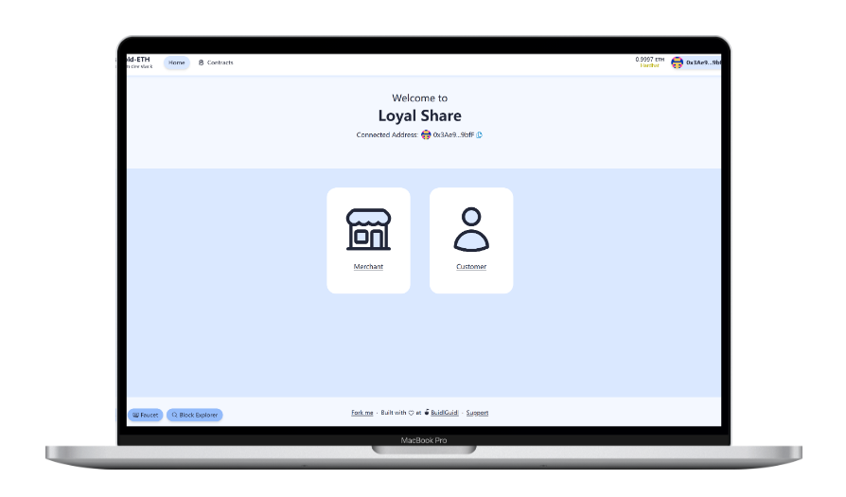
Implementation
Notes:
我们也把上述的所有功能都封装到了一个智能合约中，如图所示

Slide 16
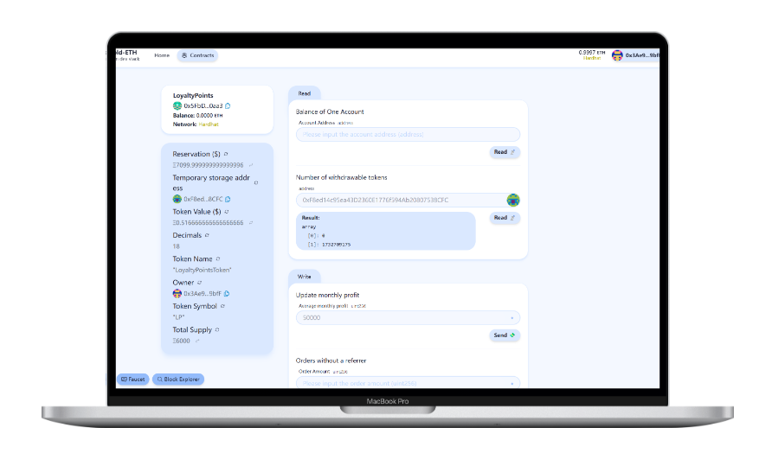
Implementation

Slide 17
Thank you for listening!

